Slide 1





2025
Helwan University
Videcto
AI-Powered Violence Detection: See What Others Can't
June 14, 2025
Dr. Islam Gamal
Department: Computer Science

Slide 2

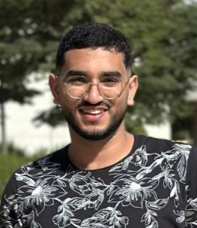

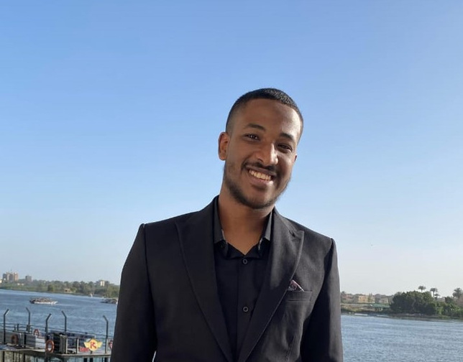
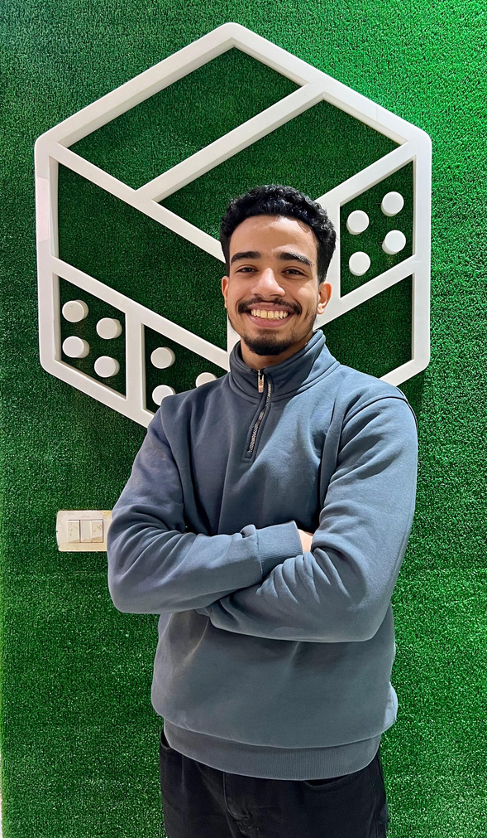
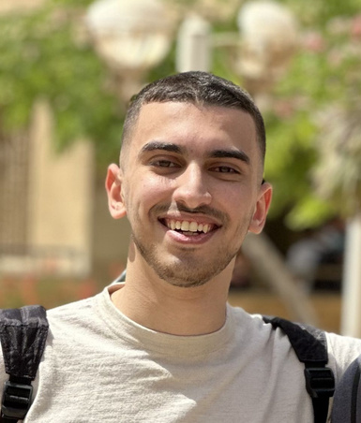
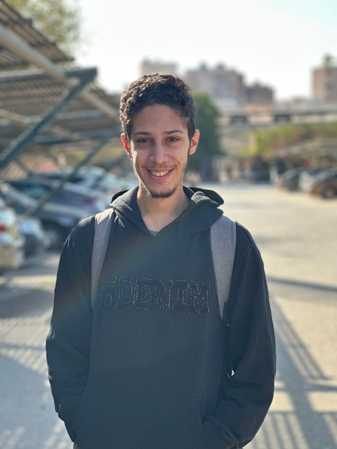
Team members
Mohamed Mostafa
Mohamed Abdelrazak
Mohamed
Awadallah
Mohamed
Nasser
Mohamed
Ayman
Yousif
Mohamed
Graduation Project
Helwan University

Slide 3


Indroduction
Graduation Project

Slide 4


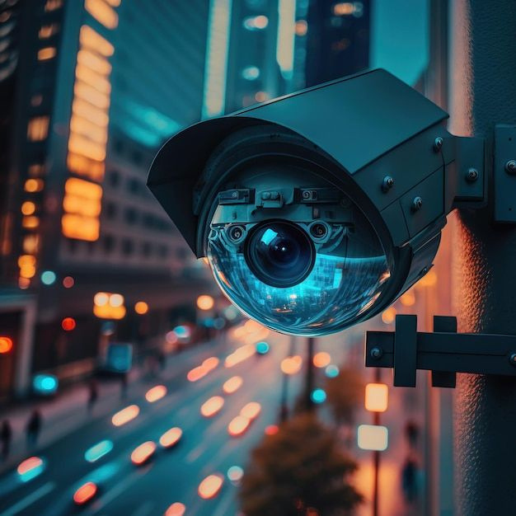
Problem Statement:
Manual monitoring is slow, inconsistent, and costly
Human fatigue causes missed or false alerts
Real-time detection is not scalable
Security teams are overwhelmed by video volume
The growing volume of digital and CCTV footage overwhelms human monitoring capacity.
Graduation Project
Helwan University
Notes:
We’re solving the problem of real-time violence detection — which current systems can’t do effectively. Human-based monitoring systems can't handle the volume or respond fast enough to emerging threats.
For example, a guard might have to watch 16 camera feeds at once, making it easy to miss a fight. Human operators also interpret incidents differently. Meanwhile, malls or campuses may have 100+ cameras, and social media receives hundreds of hours of video every minute — far too much for humans alone.

Slide 5
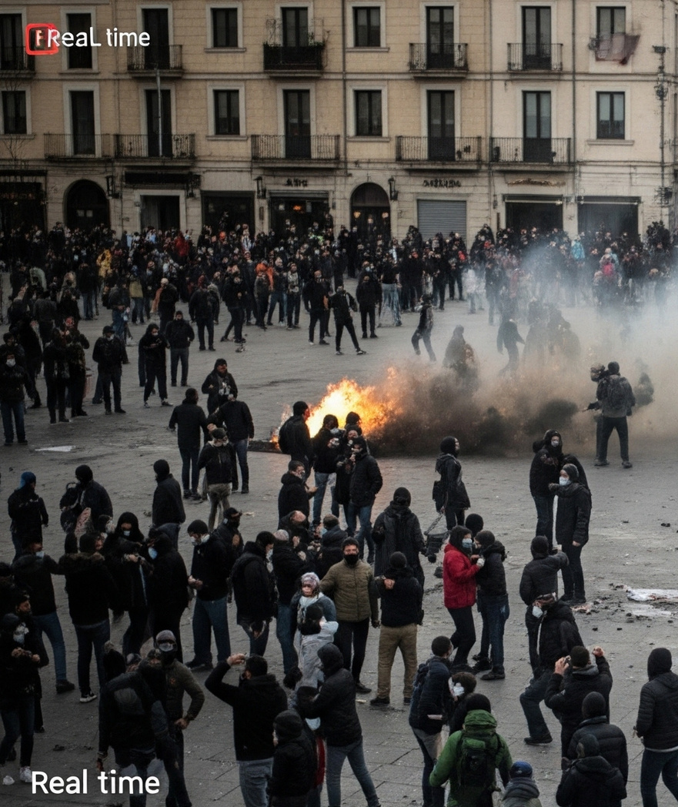
Why Is This a Real Problem
Violent incidents in public places can escalate quickly if not detected early.
Manual monitoring is prone to fatigue, error, and delay.
Content moderators face mental health risks when reviewing violent footage.
Lives, safety, and timely responses depend on fast and accurate detection.
Graduation Project
Notes:
This isn’t just an inconvenience — it’s a real safety risk. Delayed or missed detection in public spaces can cost lives. In digital spaces, it also affects user safety, moderation accuracy, and platform trust.

Slide 6
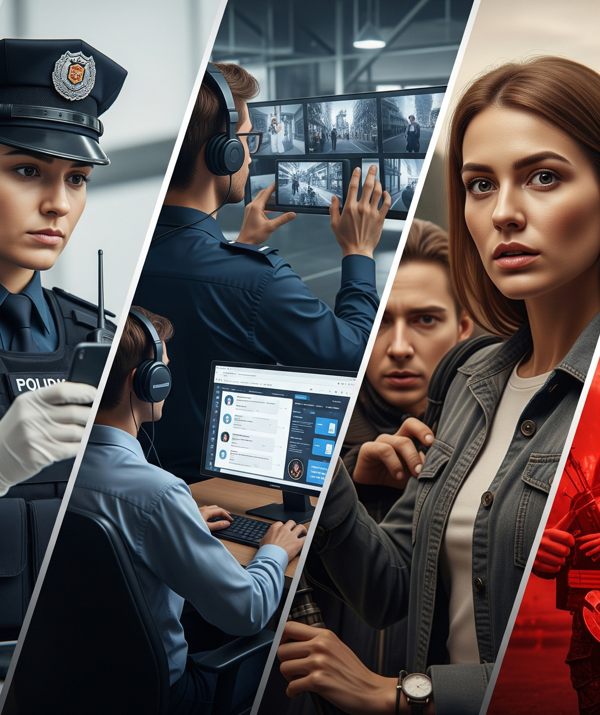
Who Is Affected by This Problem
Public safety and law enforcement teams
Security operators monitoring live CCTV feeds
Content moderators working on social platforms
Civilians exposed to undetected violent incidents
Graduation Project
Helwan University
Notes:
This problem impacts a wide range of people — from the frontline personnel monitoring footage, to the everyday people who rely on systems to keep public areas and platforms safe.

Slide 7
Motivation
Graduation Project

Slide 8
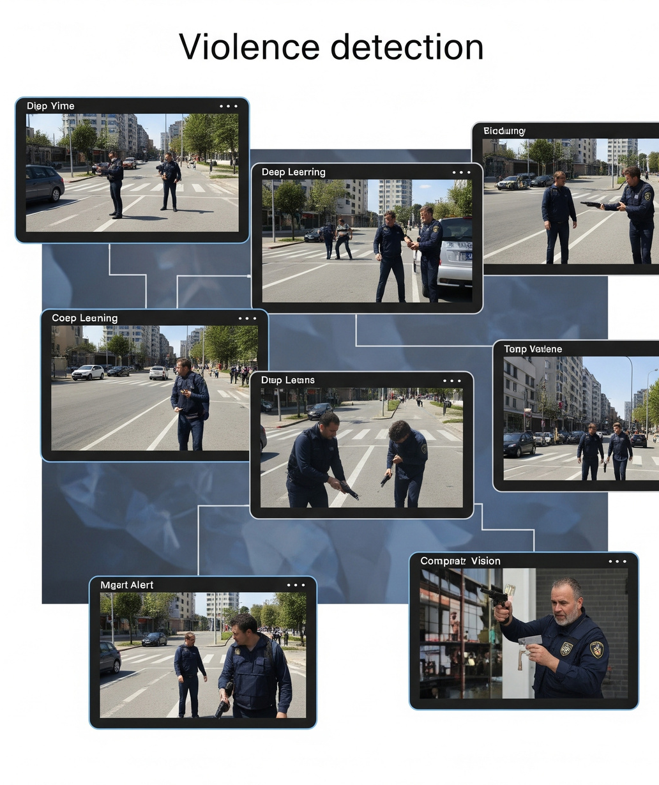
Why We Chose This Problem
Violence detection is a high-impact, real-world challenge.
Manual monitoring systems are inefficient and often unreliable.
We wanted to work on a project that combines:
Real-time system design
Deep learning and computer vision
A meaningful social use case
Graduation Project
Helwan University
Notes:
We didn’t just want a technical project — we wanted a solution that matters. This challenge combines AI, software engineering, and real-world relevance. It was a chance to apply what we've learned to a problem that could help real people.

Slide 9
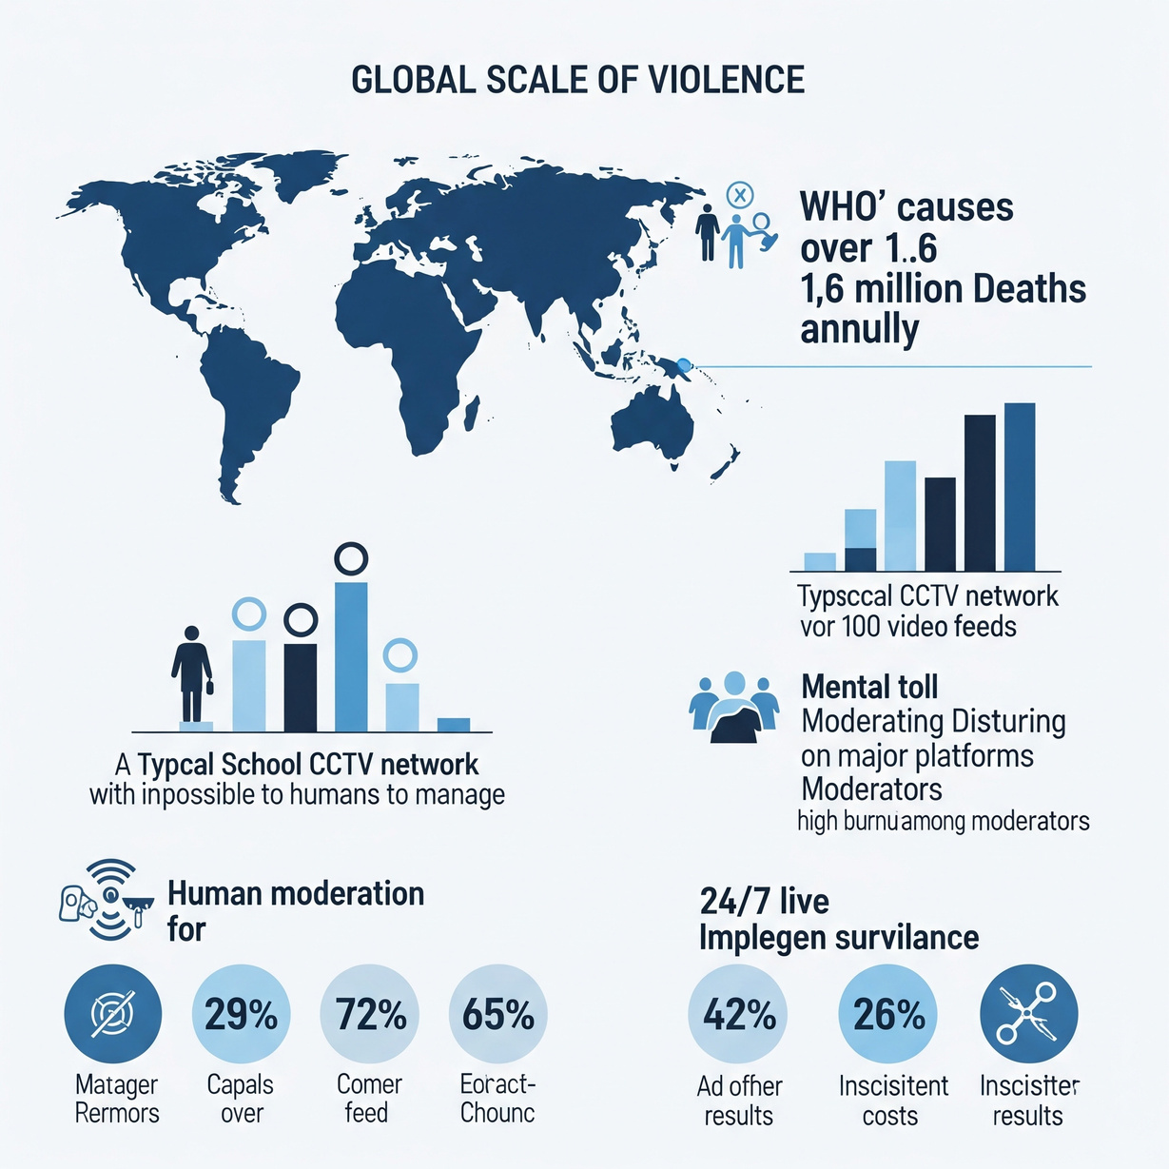
Real-World Context
According to the WHO, violence causes over 1.6 million deaths each year globally.
Social media: 500+ hours of video/minute
A single school CCTV network can have over 100 video feeds — unscalable for humans.
Manual review causes moderator burnout.
24/7 live surveillance is costly and often inconsistent.
Graduation Project
Helwan University
Notes:
These numbers and reports show that this is not a theoretical problem. From schools to cities to social platforms, the systems we rely on to catch violence are struggling — and that’s where our solution comes in.

Slide 10
Objectives
Graduation Project

Slide 11



Main Objectives
Multi-Modal Violence Detection:
Implement real-time violence detection in video streams using YOLO-based object detection
Develop sequence-based video classification using CNN+LSTM architecture for temporal pattern analysis
Achieve accurate detection of physical altercations with confidence scoring
Graduation Project
Helwan University

Slide 12
Main Objectives
Specialized Threat Detection:
Create dedicated models for gun detection with high accuracy
Implement fire detection capabilities for emergency scenarios
Develop vehicle accident detection for traffic monitoring
Graduation Project
Helwan University

Slide 13
Main Objectives
System Integration:
Build a scalable REST API service for handling detection requests
Develop a modern web interface for user interaction and monitoring
Create a desktop application for Windows.
Graduation Project
Helwan University

Slide 14
System Overview
Graduation Project

Slide 15

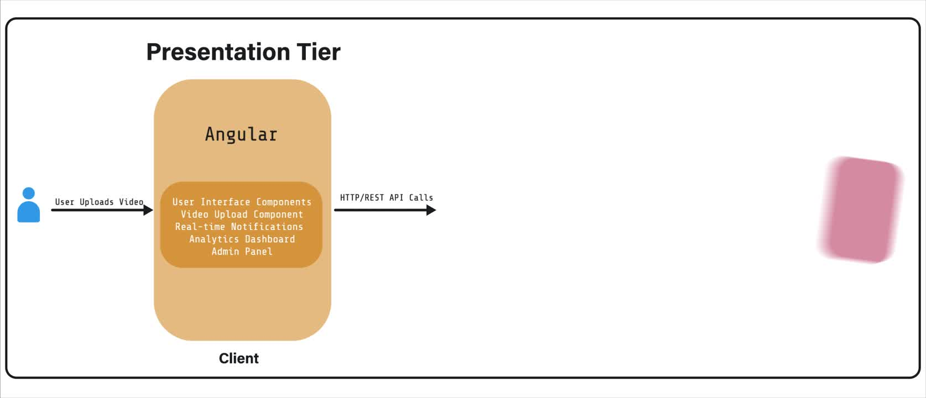
System Architecture
Graduation Project
Helwan University
Notes:
As you can see, the system consists of three main layers. The user interacts with the frontend to upload media, which is passed to the backend via REST API, then processed by machine learning models. The results are stored and returned, with real-time alerts handled via WebSockets.

Slide 16
How it works
The system follows a modern three-tier architecture:
Presentation Tier: Angular frontend for UI, media uploads and alerts.
Logic Tier: NestJS backend for routing, auth, detection, and real-time communication
Data Tier: MySQL database for storing users, uploads, and detection results
Graduation Project
Helwan University
Notes:
Our system is designed using a scalable three-tier architecture. The frontend is built in Angular and lets users upload media. The NestJS backend handles routing, authentication, and detection requests. The backend then calls AI models like YOLO and MobileNet for gun, fire, and violence detection. Results are stored in a MySQL database and sent back to the frontend. WebSocket enables real-time alert delivery, ensuring instant feedback when a threat is detected.
We separated our system into three clear tiers. The backend also manages role-based control and logs all detection data. WebSocket ensures users receive alerts in real time without refreshing the page.

Slide 17
Communication is handled through:
RESTful APIs for requests and model communication
ML models process files and return confidence scores
WebSocket for real-time detection alerts
Results stored and streamed back via WebSocket
Powered by multiple deep learning models for:
Violence, gun, fire, and object detection
Graduation Project
Helwan University

Slide 18
Methodology,
Tools & Technologies
Graduation Project

Slide 19

System Tech Stack
Frontend | Angular 19, Bootstrap FontAwesome, Socket.IO Client ngx-socket-io
Backend | NestJS 11, Prisma 6.3 JWT, Passport, Swagger Redis, Twilio, Nodemailer
Machine Learning | TensorFlow, YOLO, OpenCV CNN+LSTM, MobileNetV2
Database | MySQL + Prisma
Graduation Project
Helwan University
Notes:
e structured our stack across four main layers. Angular drives the frontend, with real-time interaction via Socket.IO. The backend is built with NestJS, Prisma ORM, and includes real-time comms and third-party services like Twilio. Our AI layer uses TensorFlow, YOLO, and custom models, while PostgreSQL and Redis power the data storage.

Slide 20
Why These Technologies
Scalability | Speed & Performance | Developer Productivity
Modular stack Real-time WS Docker-ready | GPU support via CUDA Async backend flows Optimized ML models | Prisma type-safe queries Angular CLI scaffolding Swagger API docs
Graduation Project
Helwan University
Notes:
Every tool was chosen for a reason — to help us scale, run efficiently, and develop quickly. Angular and NestJS are modular. GPU acceleration makes ML real-time. Prisma and CLI tools speed up development. Swagger ensures APIs are always documented.

Slide 21
Core System Features
Graduation Project

Slide 22
Core Features
Model Recommendation | Recommend appropriate model for a specific task
Model Trial | Test a specific model before purchase
Detection Dashboard | View history, scores, and result logs of trials
Purchase Model | Access model weights
Request Service | Request a customized model or service
Graduation Project
Helwan University
Notes:
Our system allows users to upload media, which is analyzed instantly using deep learning models. Real-time alerts are triggered for threats, and everything is stored with analytics. Role-based access allows moderators to manage users and services securely.
The system allows users to upload content and receive instant AI-powered analysis. Everything is visualized on a dashboard, and users can access specialized models like fire or gun detection. Admins have deeper controls, which I’ll explain next.

Slide 23
User Roles and Permissions
Users | Admins
Upload and analyze media Receive instant alerts View historical detections Manage profile Access detection services | Manage user accounts Control system settings Monitor analytics Deploy detection models Handle security and backups
Graduation Project
Helwan University
Notes:
Our system supports two main roles. Regular users focus on uploads and results. Admins handle configuration, model management, and analytics.

Slide 24
Demo
Graduation Project

Slide 25
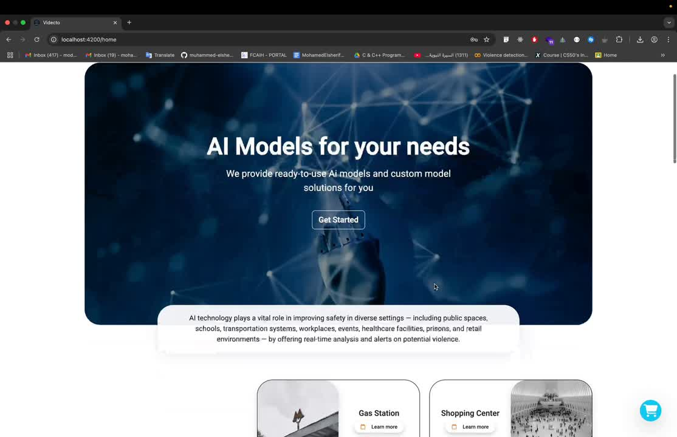
Graduation Project
Helwan University

Slide 26
Datasets
Graduation Project

Slide 27
Real Life Violence Situations Dataset:
URL: https://www.kaggle.com/datasets/mohamedmustafa/real-life-violence-situations-dataset
DESC: 2000 total videos (1000 violence & 1000 non-violence) of different situations.
ex. bare hands, weapons, 1v1, or multiple people.
UFC Dataset:
URL: https://universe.roboflow.com/graduation-projects/violence-detection-svquf/dataset/4
DESC: 958 total images with bounded boxes.
Weapon Dataset:
URL: https://universe.roboflow.com/psm-ou5fu/violence-weapon-detection/dataset/1
DESC: Violence & Weapon
Gun Dataset:
URL: https://universe.roboflow.com/instituto-superior-de-engenharia-de-coimbra-bgn4r/gun-surveilence/dataset/1
DESC: 600 augmented images with bounded boxes.
Fire & Smoke Dataset:
URL: https://universe.roboflow.com/middle-east-tech-university/fire-and-smoke-detection-hiwia
DESC: ~6k images with bounded boxes.
Hate Speech Dataset:
URL: https://www.kaggle.com/datasets/fangfangz/audio-based-violence-detection-dataset
DESC: 340 audio files with labels.
Graduation Project
Helwan University

Slide 28
Models
Graduation Project

Slide 29
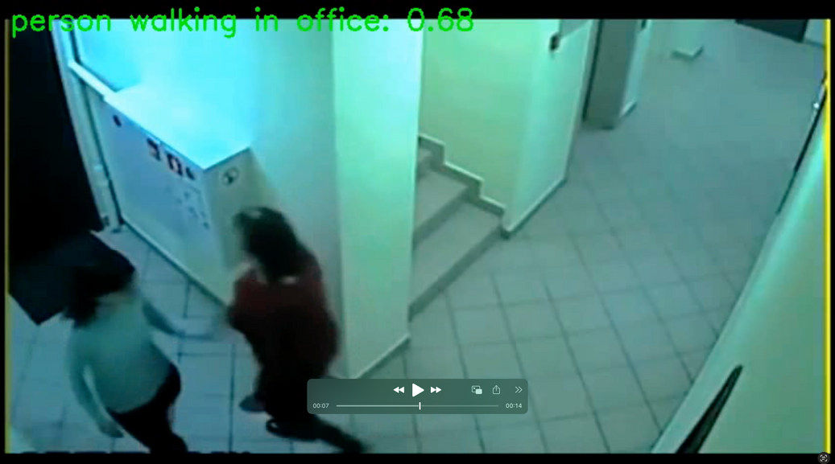
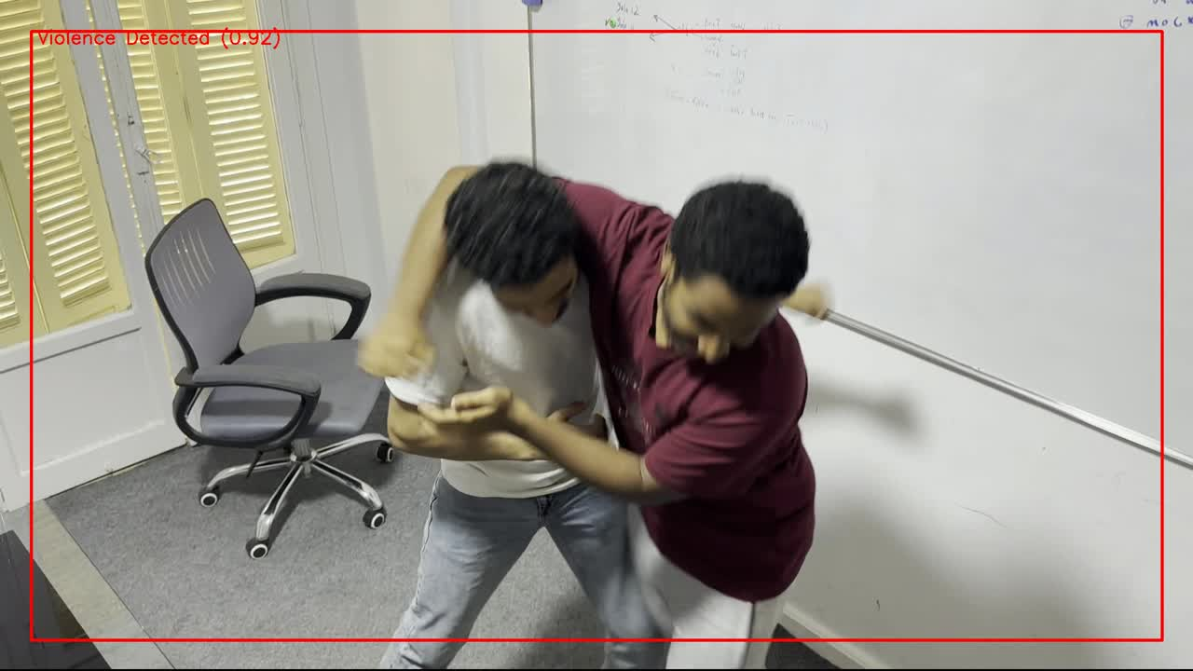
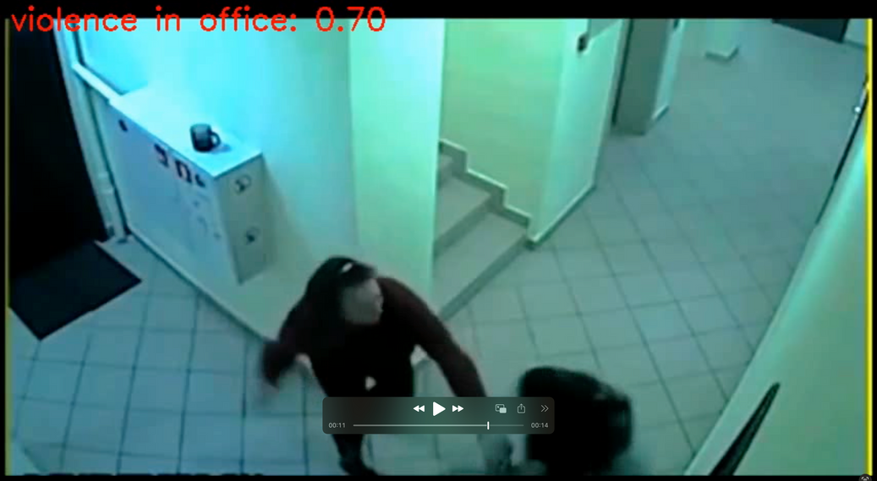
Violence Detection - Current Models
Customized Model: CNN (from scratch)
Pretrained Model: YOLOv8 & CLIP
Graduation Project
Helwan University
Notes:
Violence Detection
Customized Model: CNN (from scratch)
Pretrained Model: YOLOv8

Slide 30
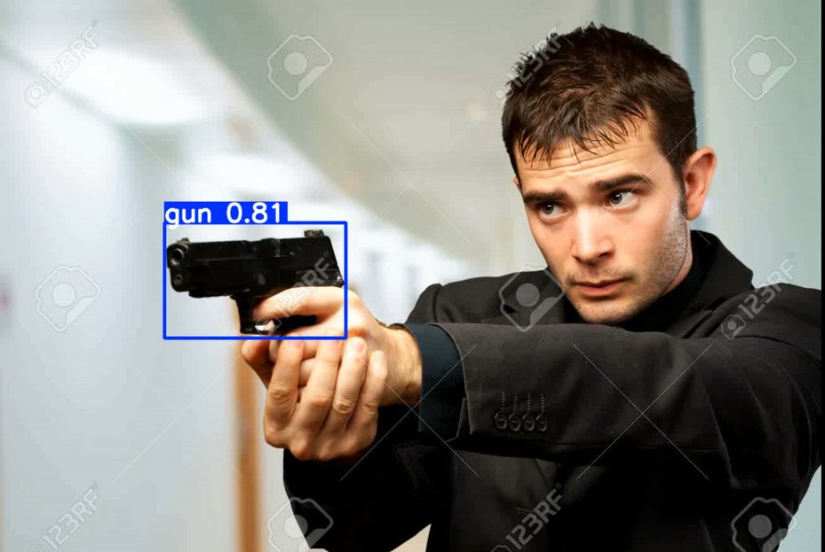
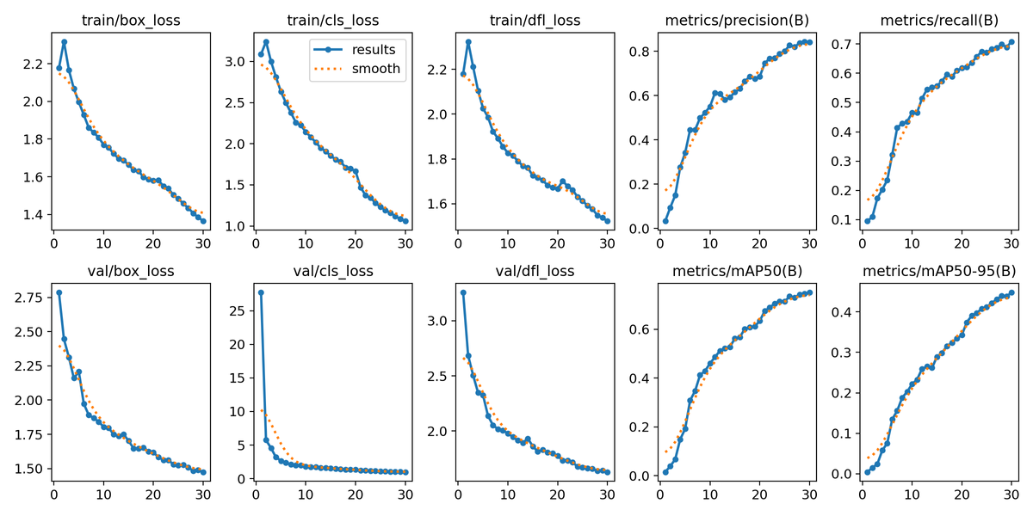
Gun Detection - Current Models
Pretrained Model: YOLOv11
Graduation Project
Helwan University
Notes:
Gun Detection
Pretrained Model: YOLOv11

Slide 31
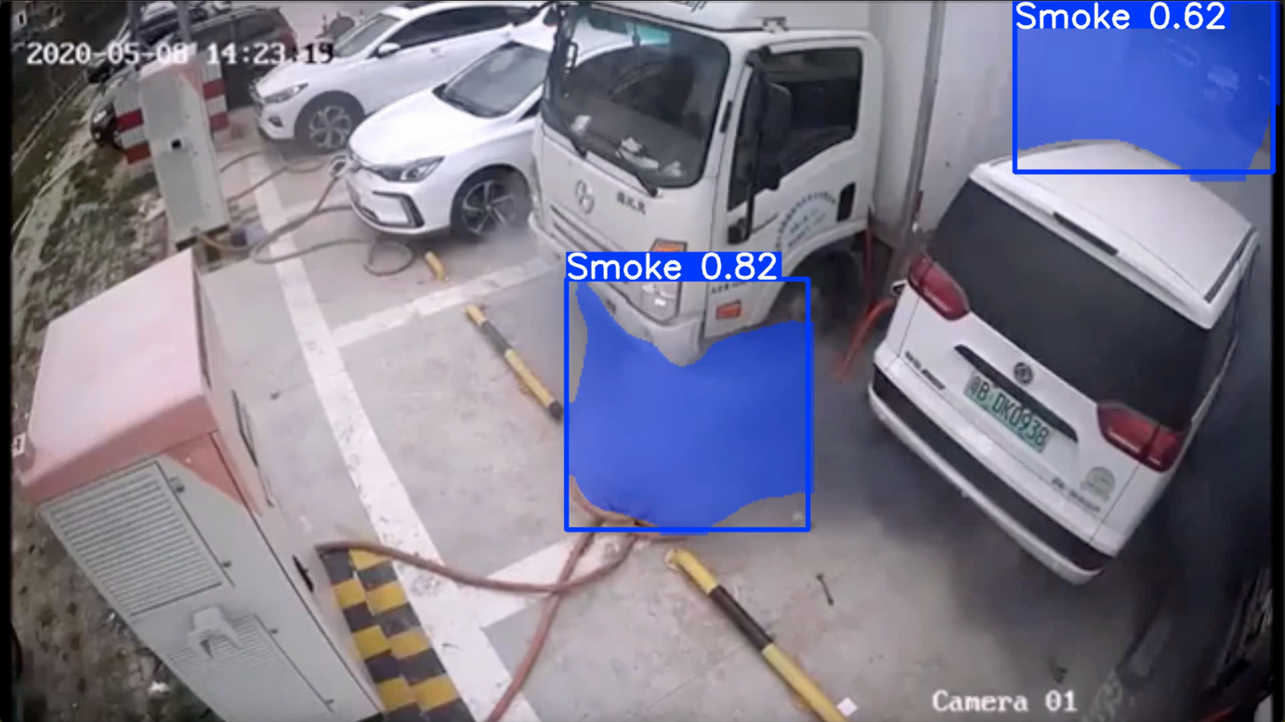
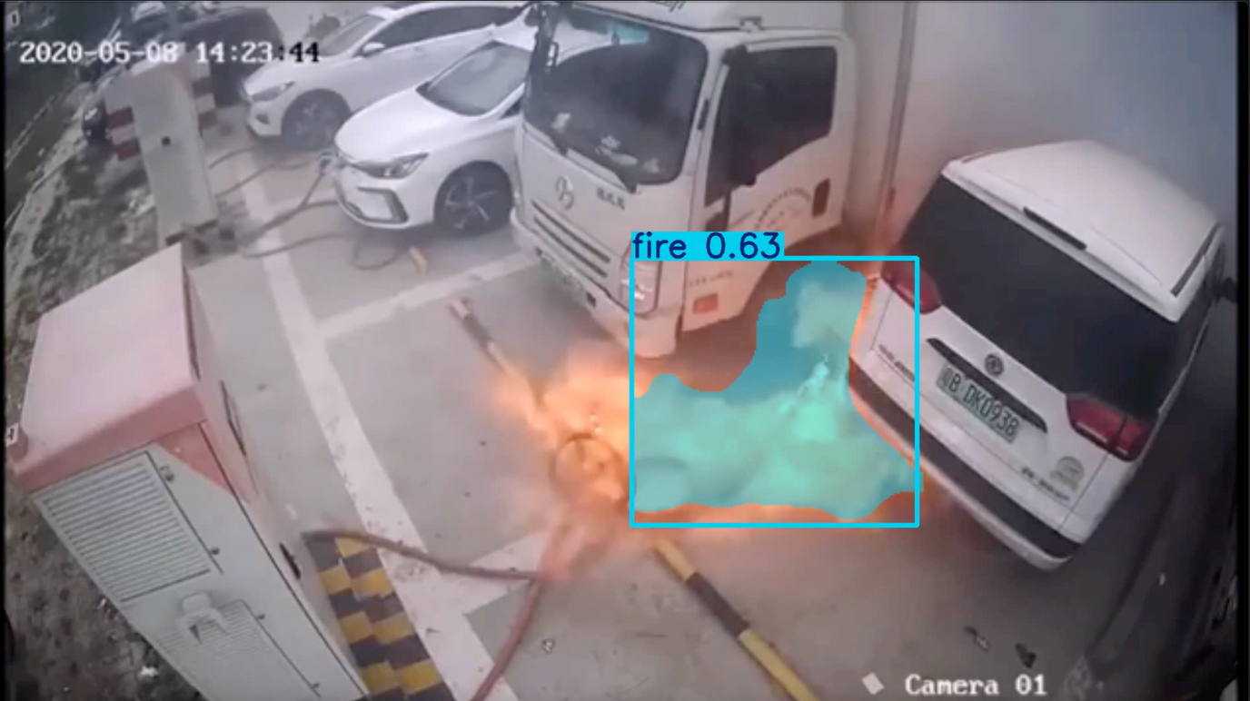
Fire & Smoke Detection - Current Models
Pretrained Model: YOLOv11
Graduation Project
Helwan University
Notes:
Fire & Smoke Detection
Pretrained Model: YOLOv11

Slide 32
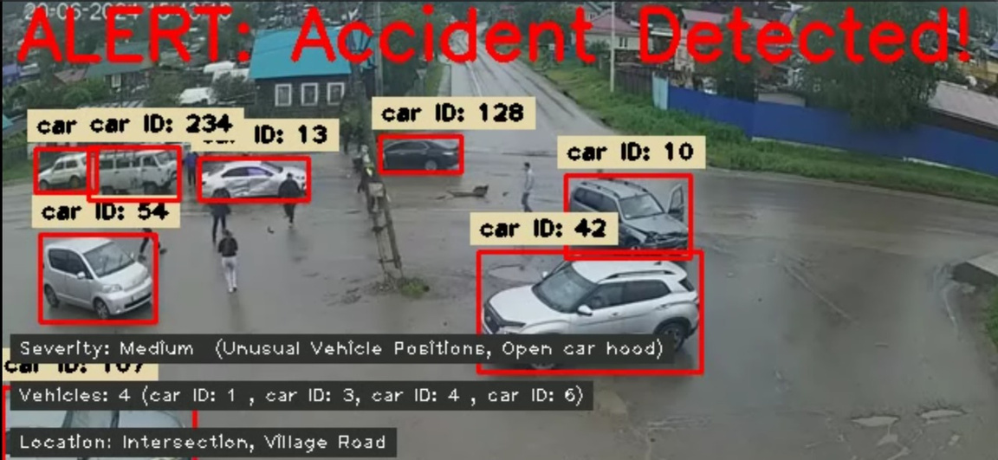
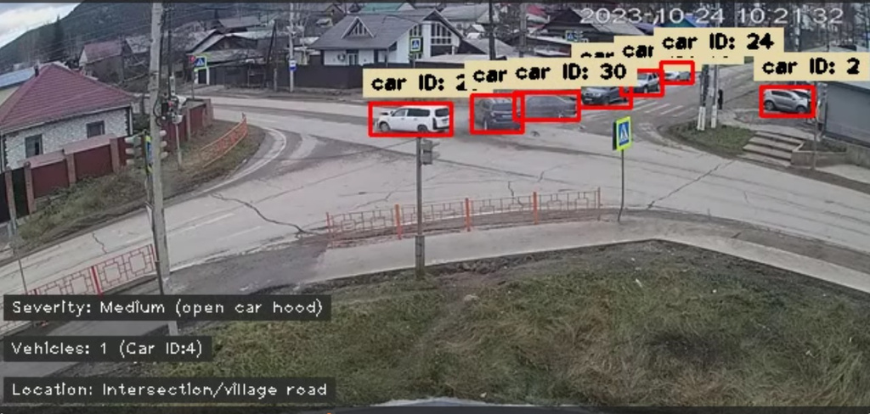
Car Crash Detection - Current Models
VLM (Vision-Language Model)
Graduation Project
Helwan University
Notes:
Car Crash Detection
Model Type: VLM (Vision-Language Model)

Slide 33
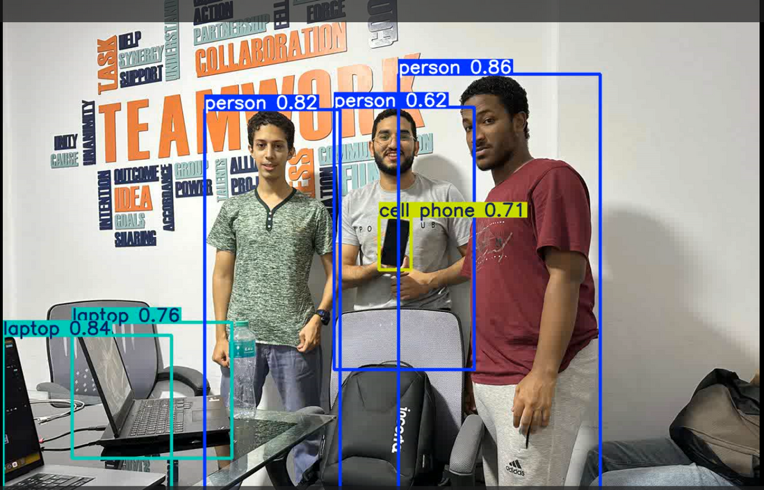
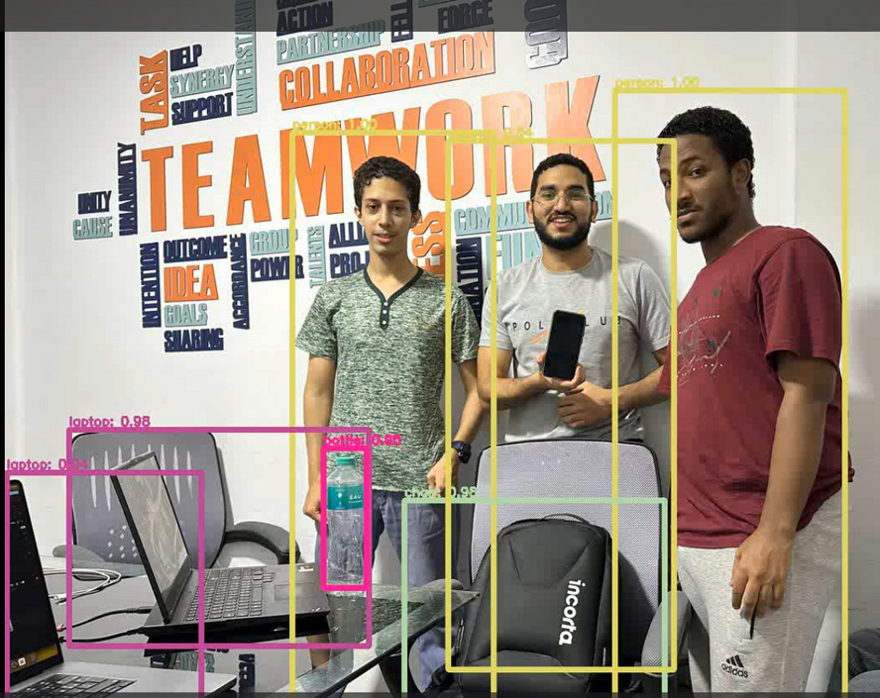
Object Detection - Current Models
YOLOv11
YOLOv3 with COCO names
Graduation Project
Helwan University
Notes:
Object Detection
Pretrained Models:
YOLOv12
YOLOv3 with COCO names

Slide 34
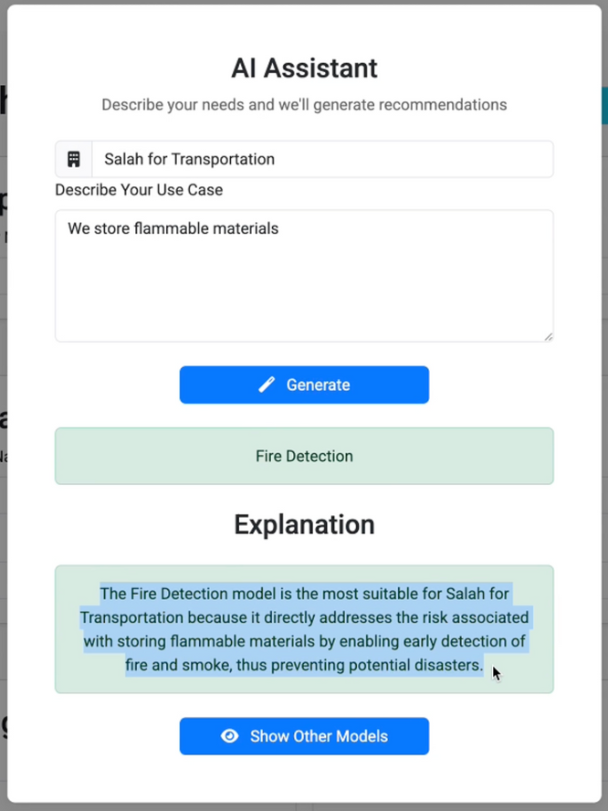
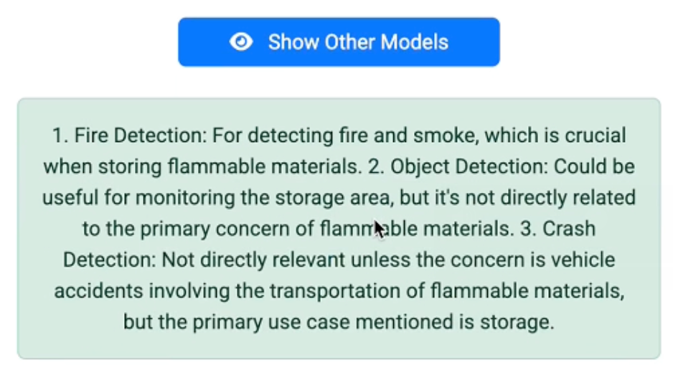
Model recommendation
LLM (Large-Language Model)
Graduation Project
Helwan University
Notes:
Car Crash Detection
Model Type: VLM (Vision-Language Model)

Slide 35
Under Development Models
Hate Speech Recognition
Traffic Detection
Sentiment Analysis (Twitter, imdb)
Graduation Project
Helwan University
Notes:
Traffic Detection
Customized Model: CNN (from scratch)

Slide 36
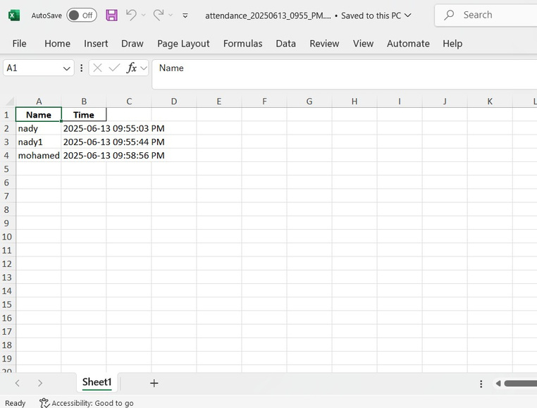
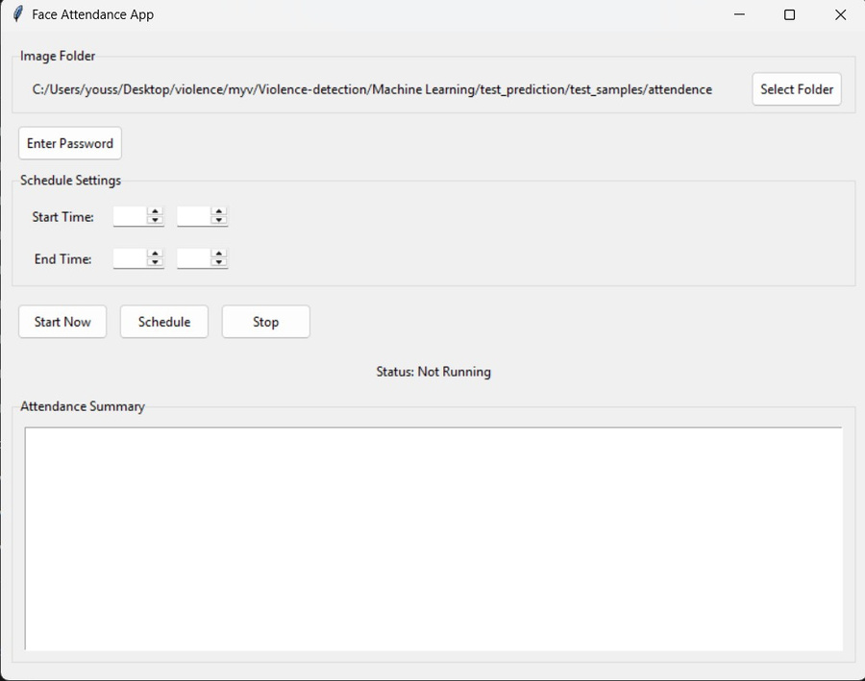
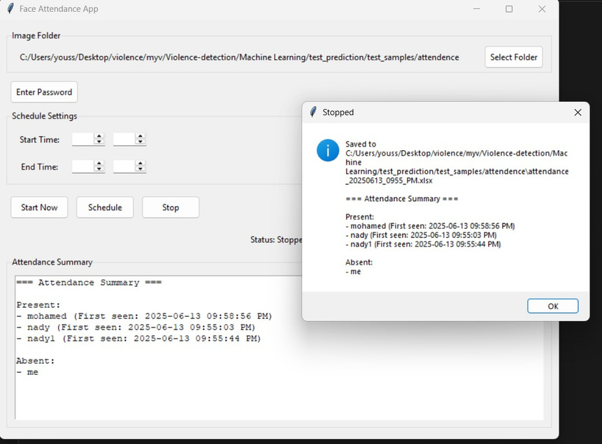
Current Applications
Attendence Desktop Application
Graduation Project
Helwan University
Notes:
Car Crash Detection
Model Type: VLM (Vision-Language Model)

Slide 37
Limitations & Future Work
Graduation Project

Slide 38
System Performance Overview
Inference Time | ~48ms per image (YOLO)
GPU Memory Usage | 11.3 GB
Backend Response Time | 50ms per full request
Average Detection Time | 0.88s per image (accidents)
False Positive Rate | < 9% overall
Graduation Project
Helwan University
Notes:
Overall, the system delivers real-time performance with low latency. Our backend handles detection requests in just over 1 second, and model inference is GPU-accelerated for speed. With false positive rates under 6%, we maintain high reliability for alerting.

Slide 39
Challenges and Limitations
Model and Processing Limitations | System & Deployment Limitations:
CNN has test accuracy (90%) and high inference time Gun detection recall is moderate (52.5%) Our models require 11.3GB GPU memory Limited frame rate and format support | Real-time streaming and need scaling support Single-threaded video processing Fixed confidence thresholds and no dynamic tuning Basic security and error handling Requires CUDA GPU for full performance
Graduation Project
Helwan University
Notes:
While the system works well in controlled settings, we encountered challenges like limited accuracy in some models, high GPU demand, and video processing constraints. Deployment also lacks real-time stream handling and dynamic scaling, which we aim to improve.

Slide 40
Future Work and Enhancements
Model Improvements
Multi-class violence detection
Temporal pattern analysis and audio integration
Ensemble and self-learning models
System Optimizations
Security & Deployment
Parallel & batch video processing
Real-time monitoring and model tuning
Mobile apps & customizable dashboards
End-to-end encryption
Secure user authentication
Cloud & containerized deployment
Graduation Project
Helwan University
Notes:
We're planning to expand detection types, improve response speed, and support real-time environments. Enhancing security, scalability, and performance are key goals — including deploying on cloud platforms and building a mobile app.

Slide 41

Conclusion
Graduation Project

Slide 42
Conclusion
This project integrated machine learning, full-stack web development, and real-time communication to build a robust violence detection system. Using a modern three-tier architecture, the system supports violence, fire, gun, and accident detection from both image and video inputs. We implemented an Angular frontend, a NestJS backend, and Python-based ML services using models like YOLO, RNN, and CNN. The platform supports real-time alerts, model management, user roles, and service customization. Our system delivers strong performance across use cases and provides a scalable foundation for future improvements.
We thank our supervisor, evaluation committee, and team members for their guidance and collaboration.
Graduation Project
Helwan University
Notes:
Throughout this project, we tackled real-time processing, model integration, and full-stack coordination. We learned how to bridge ML with a scalable web app, use tools like WebSocket, FastAPI, and Prisma, and optimize model performance. It’s been an intense, valuable experience — and we’re proud of what we’ve built. Thank you again to our supervisor, committee, and team.

Slide 43



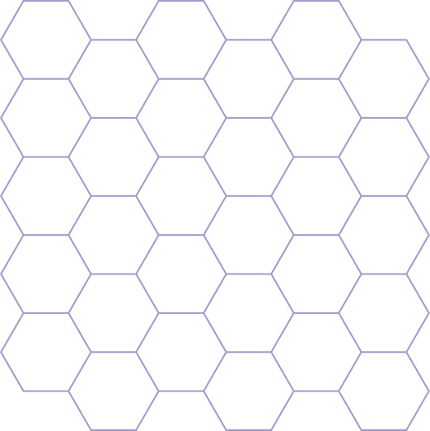
Questions & Discussion
Thank you! We’re happy to take any questions.

Slide 44
Thank You
We appreciate your time and feedback.
Graduation Project

